Slide 1
LAK Hackathon
About the theme

Slide 2
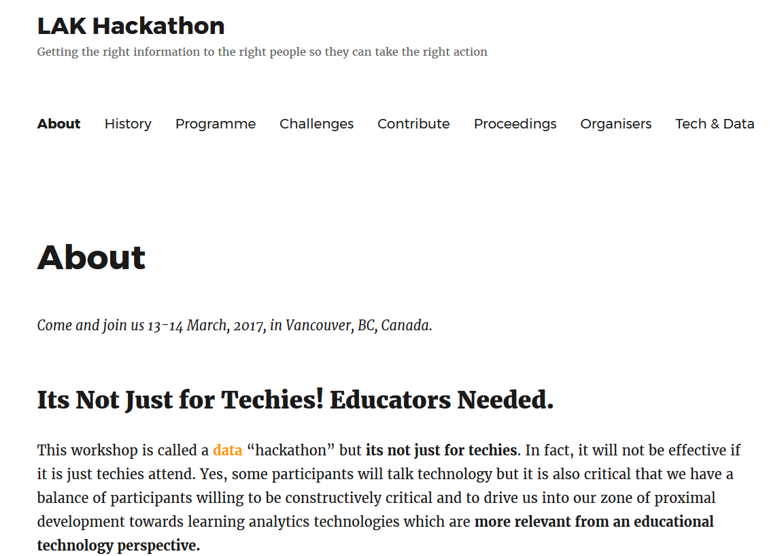
https://lakhackathon.wordpress.com/

Slide 3
https://lakhackathon.wordpress.com/
Notes:
Show of hands:
How many educators/ Ed techs?
How many computer scientists?
How many data scientists?
How many administrators?
Students?
Others?
Rest of this presentation aimed to help to offer some context of educators/ ed techs – hopefully help to explain some of their asks as it relates to data & analytics.

Slide 4
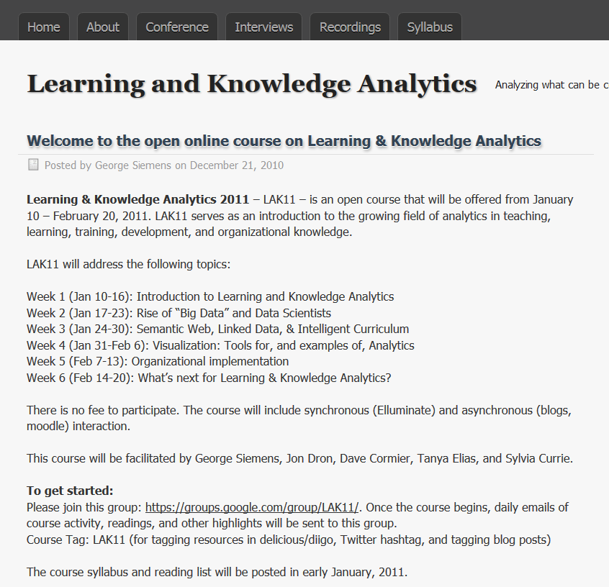
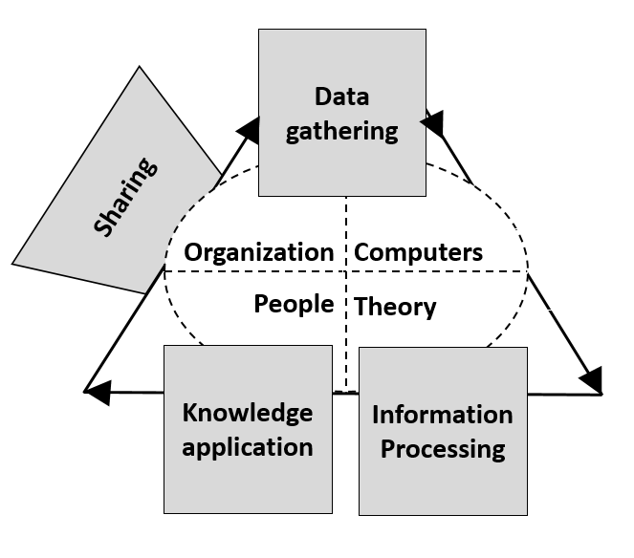
A look waaaaayyyyyy back…… to 2011
http://www.learninganalytics.net/?p=28
Notes:
Going back to the beginning, learning analytics was being driven by folks with a background in education. In my early model, computers were going to be one small part of it. Organizations, people and theory were also critical components. How well are these pieces currently being represented within learning analytics.

Slide 5
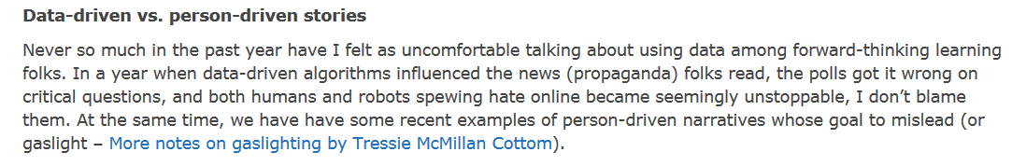
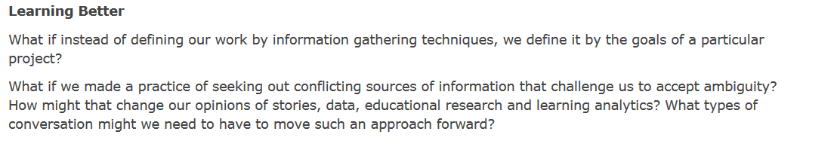
Deciding better, learning better: Different kinds of stories
http://heretothere.trubox.ca/deciding-better-learning-better-different-kinds-of-stories/
[ fast forward to the end…]
Notes:
I wrote a blog post to find out. I didn’t get a lot of comments, but the ones I did get reinforced the objections and concerns that I hear daily when it comes to the use of data in relation to learning.

Slide 6
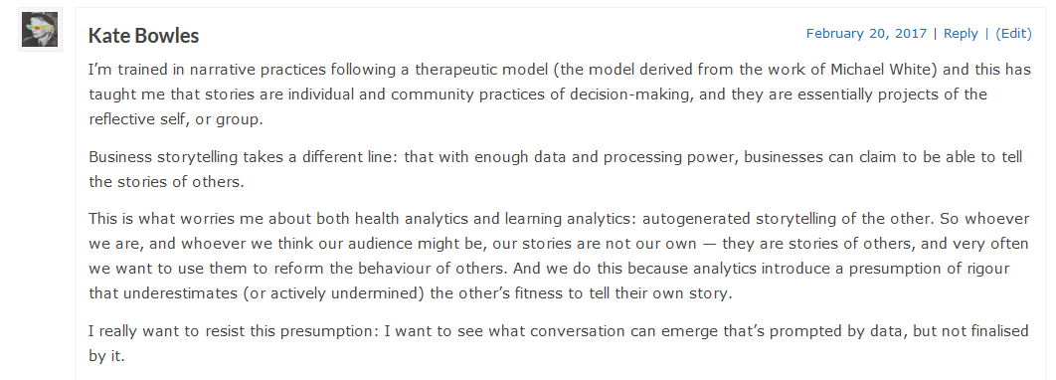
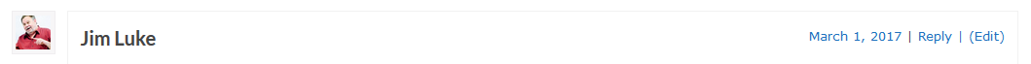
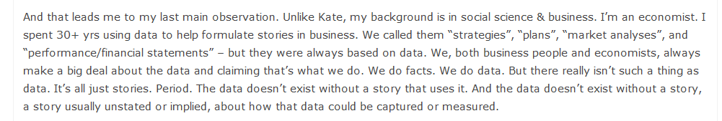

Slide 7
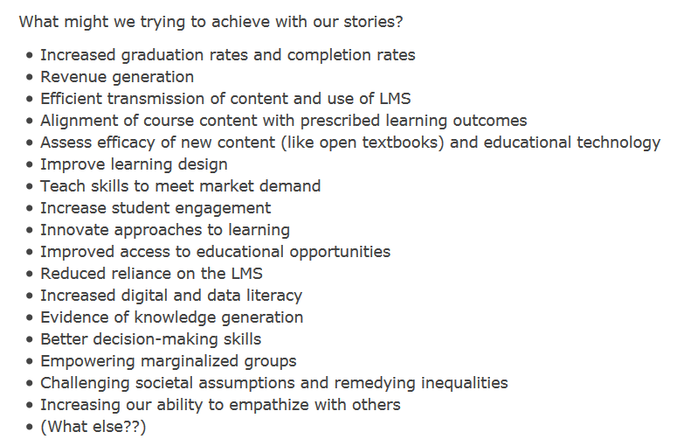
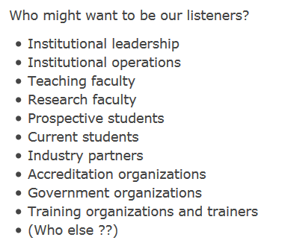
Notes:
So as we talk about the challenges and especially the development of dashboards, I’d encourage you to think about the stories wrapped around them? Whose story are we telling? Who are the listeners? Why are the listeners asking for the things in the challenge? What other data stories might these audiences benefit from? How do we ensure we are prompting conversation that are based on the data but not finalized by it?

Slide 8
Lightening talks & challenges

Slide 9
Challenge 1 Making Predictive Analytics Safe for Student Consumption

Slide 10
Challenge! Making Predictive Analytics Safe for Student Consumption
Can we make???
Which ways of communicating the results of learning analytics to students* – without intermediation through a professional – are desirable, effective, and free from unacceptable side-effects?
* - scope = counterpart to staff dashboards of predictive analytics
Adam Cooper, Tribal Group, LAK Hackathon 2017

Slide 11
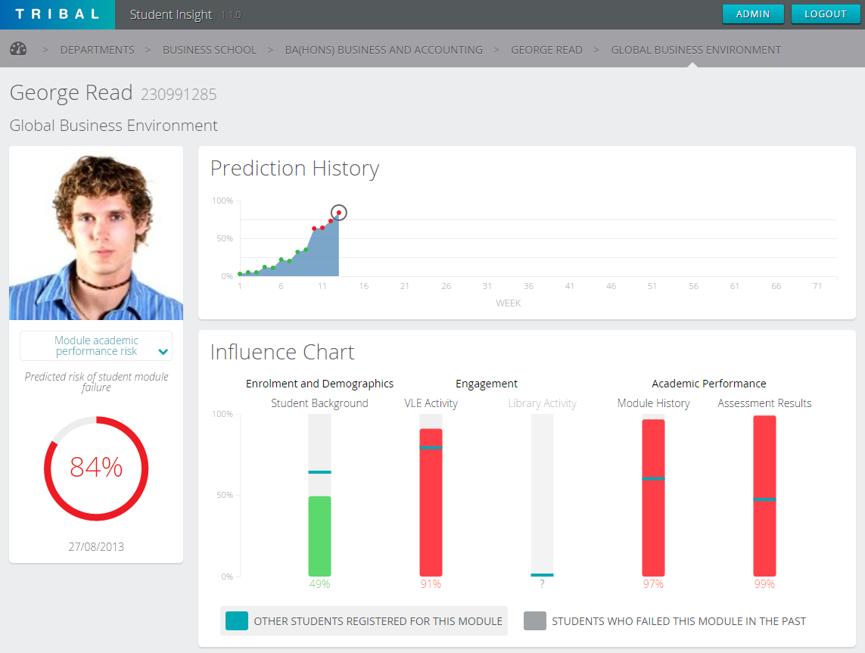
Unmediated Staff Dashboards = Danger
Emotional
Self-fulfilling prophecies
…
Behavioural
Chasing proxies
Gaming
…
Epistemological
LA != truth
…
Interpretational
So what should I DO???
Numerical/statistical literacy
…
Student Insight API available for Hackathon

Slide 12
Presented by Adam Cooper, Tribal, on March 17th 2017 at the 7th International Learning Analytics and Knowledge Conference in Vancouver, Canada.
© Tribal Group 2017
Licenced for use under Creative Commons Attribution 4.0 International https://creativecommons.org/licenses/by/4.0/
Attribution should be “Adam Cooper, Tribal Group”

Slide 13
Challenge: Making Predictive Analytics Safe for Student Consumption
Overview: We are now becoming accustomed to the idea that predictions of various kinds of outcome being presented to staff to help them to provide guidance to students is one of the main applications of Learning Analytics in the period to 2020. Staff expertise and conversational skills help to interpret and contextualize what the data indicates and to formulate a plan of action with the student.
Challenge: design ways of communicating the results of predictive learning analytics to students – without intermediation through a professional – that are desirable, effective, and free from unacceptable side-effects?
This should consider a range of dangers including:
Emotional responses to predictions of failure and the variety of psychological tendencies/states.
Gaming the system
Students chasing proxies for learning
Belief that the numbers don’t lie
Not everything that matters is counted and not everything that is counted matters
Difficulty in translating “I have a problem” to “this is what I can do about it”
Numerical/statistical illiteracy and jumping to the wrong conclusion

Slide 14
Challenge 2 System Level Ed Tech dashboard

Slide 15
Challenge - Ed Tech dashboard: System Level
Overview: Usually there is a learning technology group that is responsible to provide support to end users, guide pedagogical uses of the system and making recommendations about plugins/ enhancements to recommend or decommission. Currently most of these folks have little other than anecdotal evidence what systems users are doing, need and want.
Question | Measures | Follow up question | Why it’s important
Are people using Moodle help? | % of users accessing help Top issues | Built in? External linked to system? Why aren’t they accessing help? | Help determine if we need to start with using faculty to use help or improving help docs. Identify common areas of confusion for improved documentation and training
What tools are being used within Moodle? | # of users using each tool | Drill-down to list of users | Decide which tools to turn off/ replace – Have easy contact list of impacted users
What types of activities are faculty inserting into their courses? | Top types of activities % of faculty using each type | Filter by faculty & compare | Better understand how faculty are using the system
Are students accessing learning resources/ activities? | Highest used Not used in last x months | In Moodle, linked content, external videos, wordpress, articulate & H5P | Better allocate resources/ consider removing content (stop updating) content no one is using
How much time are faculty spending in Moodle? | Time spent on “set up” activities Time spent in discussions | Time/ specific set up activity Change in the time spent over time with ability to filter | Improve documentation/ support/ training to minimize time faculty are spending on system set up – Measure efficacy of efforts

Slide 16
Challenge 3 Measuring Engagement

Slide 17
The Every Student Succeeds Act (SSA) has a multiple-measures requirement that has opened the door in some states to looking at measurements of social and emotional learning (see http://edwp.educ.msu.edu/green-and-write/2016/social-emotional-learning-states-consider-new-accountability-indicator/ ). According to Carini, Kuh, and Klein (2006), "Student engagement is generally considered to be among the better predictors of learning and personal development."[1] How do we quantitatively measure student engagement (e.g. for educators, administrators, etc.) and get the measurements to the right people in a way that helps improve (directly or indirectly) the student learning experience? [1] Carini, R. M., Kuh, G. D., & Klein, S. P. (2006). Student engagement and student learning: Testing the linkages. Research in higher education, 47(1), 1-32.
Notes:
Devin

Slide 18
Challenge 4 Hierarchy of visualizations/ templates

Slide 19
Design a hierarchy of visualizations based on Learning Sciences covering all teaching styles aligned with proxy variables
Method
Document which styles and variables
xAPI statements in templates with example tsv files
Mock up visualizations
https://docs.google.com/presentation/d/1HwghKv2gbx8grh15r43cnpTO3nNnsulqbI1ORKcuJ1I/edit?usp=sharing

Slide 20
Challenge 5 ???????

Slide 22
Challenge 6 Online Faculty/Course level dashboard

Slide 23
Challenge Online Faculty/Course level dashboard
At course level, there are two issues : interaction with students (opt-in faculty dashboard) – need student info and course design – anonymous data preferred.
Question | Measures | Follow up question | Why it’s important/ Notes
Student login | Students who haven’t logged in in last x weeks Students who have logged in regularly but have submitted 0 assignments |  | To enable instructor intervention, especially in online courses
Are students accessing learning resources within the course? | Name of students who completed Highest used Not used in last x months | In Moodle, linked content, external videos, wordpress, articulate & H5P | Student struggling – point to resource & Course design
Are students doing optional assignments? | Names of students who completed % of students completing assignments Never used | In moodle? Accessing content video/ h5p/ Wordpress outside of Moodle | Student struggling – point to resource & Course design
Do students feel the activities are helpful | Thumbs up/ down and Short (144 character) why? |  | Approx. 5-10/ course Course design
Social network analysis (SNAPP-like tool) | Who is talking to who? When? About what? |  | Improve structure of discussion forums
How long are they watching videos? | Time/video % of video |  | Student struggling – point to resource & Course design
What questions did students get wrong? | Anonymous roll-up of answers/ question on quiz |  | Allows faculty to the decide: Hard question? Question flawed? Didn’t teach it right?
How are students navigating through the course? (Pattern to completion) | Map to complete/ incomplete (P/F) | Are there any key differences between successful & not successful students? | Course design

Slide 24
Challenge 7 Data literacy playground

Slide 25
Challenge Data literacy playground: Student level
Overview: We live in a world of data. Students are often asked to sign consent forms, but their privacy rights are really not ever explained to them. They have been using Google, Facebook etc since grade school but have likely never seen the type of data these systems are gathering and how it is changing what information is displayed back to them.
Universities also gather a lot of data about students in LMSs, student information systems, via Eduroam, mobile apps…
In many industries, we create training environments that mimic the real world but with anonymized data.
Challenge: Create a training environment for university students in which a small subset of anonymized data collected about students via all of the university systems are made available to faculty and students.
This system could be used for a variety of purposes including:
Illustrating privacy impact during privacy conversations (ideally) whenever consent forms are signed
Learning about privacy law
Allow students to find out what types of information are being gathered about them
Enable conversations about data that are complicated and as a result tend to be avoided
Support discussions about: Trust, ethics, terms of use in Moodle, uncertainty and fear
Discussing the potential of data as a “permanent learning record”
Transparent development of ethical norms
Students to develop apps & participate in learning analytics
Discussing assumptions around of data. Tracking time in system. Value of students contribution? Faculty?

Slide 26
Challenge 8 ???

Slide 28
Challenges
Making Predictive Analytics Safe for Student Consumption
System Level Ed Tech dashboard
Measuring engagement
Hierarchy of visualizations/ templates
???
Online Faculty/Course level dashboard
Data literacy playground
?????
Links
https://lakhackathon.wordpress.com/tech-data/
https://lak17hackathon.slack.com/

